Slide 1
CSC 280 Project Bison and Flex: Calculator
CSC 280- Principal of Programming Language
Group: David Ajqui-Diaz, Adrian Dionicio Silva, Micheal Gerbitz,

Slide 2
Introduction
How to install Flex and Bison in Ubuntu:
Open a terminal by pressing [CTRL] + [ALT] + T. Then, type one of the the following commands:
This command is more basic:
sudo apt-get update sudo apt-get upgrade sudo apt-get install flex bison
What is Flex and Bison? (Online Definition from sources)
Flex is a scanner generator tool for lexical analysis, based on finite state machine(FSM). The input is a set of regular expressions while the output is the code to implement the scanner according to the input rules.
Bison is a LALR(1) parser generator tool for syntax analysis, based on pushdown automata (PDA). The input is a set of context-free grammar (CFG) rules, and output is code to implement parser based on the input rules.

Slide 3
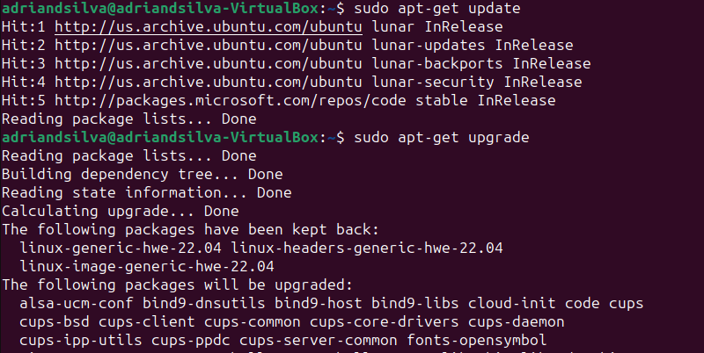
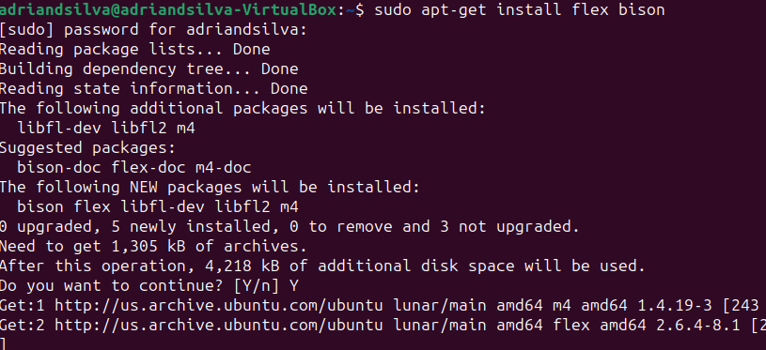

Pictures of Installation of Flex and Bison in Ubuntu

Slide 4
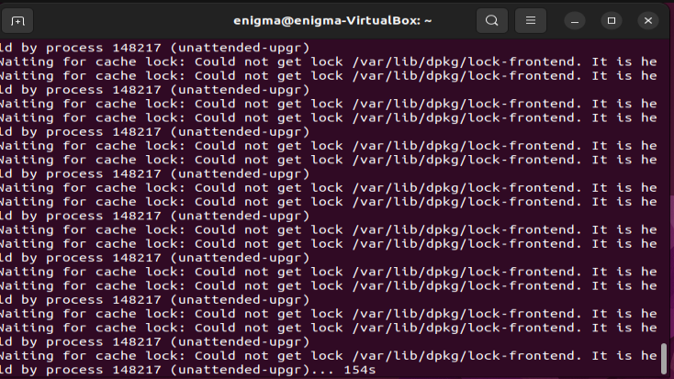
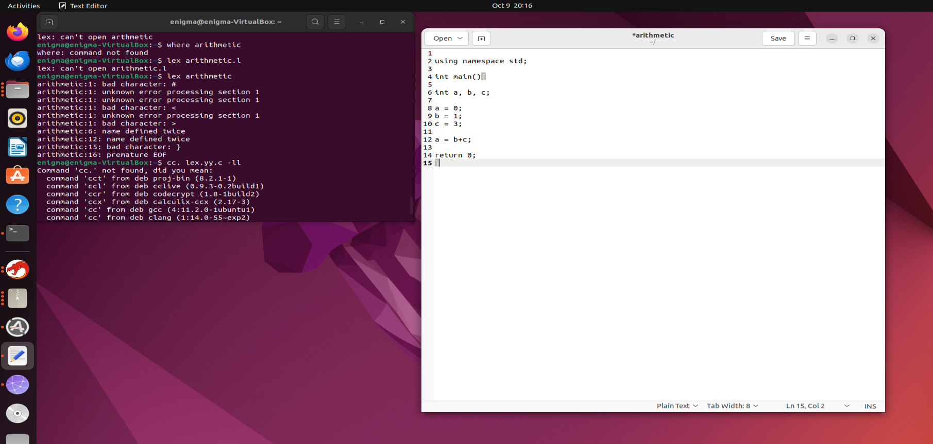
First Trial of Flex and Bison

Slide 5
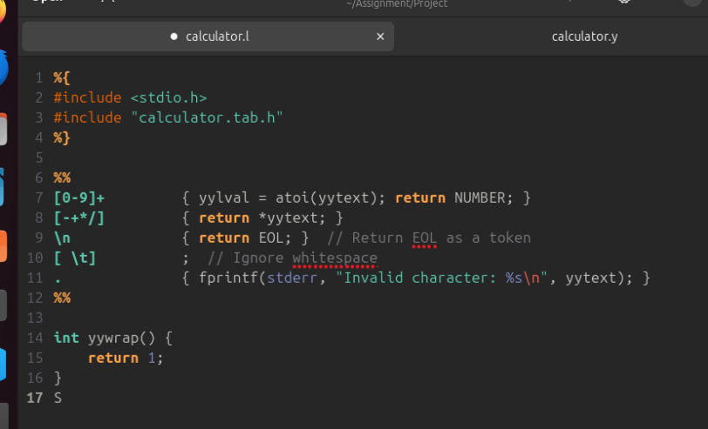
Updates to Code: Flex part of the simple calculator

Slide 6
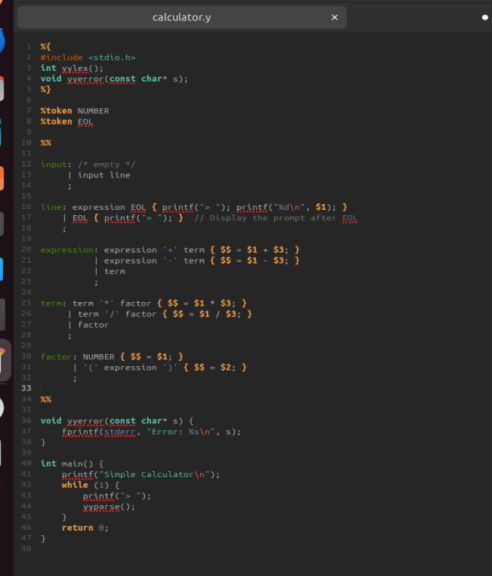
Bison part of the simple calculator

Slide 7
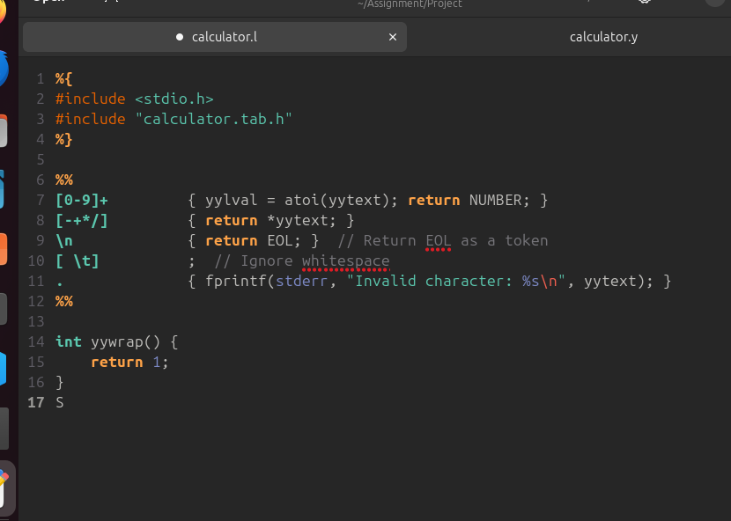
Process behind the Flex code:
%{
#include <stdio.h>
#include "calculator.tab.h"
%}
Within this sections, you are able to copy C code directly into the generated lexer code. Thus, the included input/output headers and Bison header file is included to perform communication for the lexer and parser.

Slide 8
Process behind the Flex code:
%%
[0-9]+ {
yylval = atoi(yytext); // Convert the matched text to an integer and store it in yylval
return NUMBER; // Return the NUMBER token
}
[0-9]+
rule that matches the sequence of one or more digits
{
Open brace starts the action linked with the rule
Yylval = atoi(yytext);
When digits are matched, it converts the matched string (yytext) to an integer and assigns it to yylval, which is a Bison variable holding the value of the token and then returns the NUMBER token.
Return NUMBER;
Tells the lexer to return the NUMBER token to the parser with the associated value yylval being the integer value of number

Slide 9
Process behind the Flex code: (c0nt.)
[-+*/] {
return *yytext; // Return the operator as a token
}
[-+*/]
Rule matches the correct operators together.
return *yytext;
line returns the matched operator as a token, the yytext represents a character and returns the operator as a single-character token.

Slide 10
Process behind the Flex code: (cont.)
\n {
return EOL; // Return EOL (End Of Line) as a token
}
\n
Rule matches newline characters, signaling the end of a line
return EOL;
Returns the EOL token to the end of the current line
[ \t] { // Ignore whitespace and do nothing
}
Rule matches whitespace characters like space and tab
. {
fprintf(stderr, "Invalid character: %s\n", yytext);
}
Rule that matches with characters not matched by previous rules
fprintf(stderr, "Invalid character: %s\n", yytext);
Prints an error message in response to the output stating a invalid character was found

Slide 11
Process behind the Flex code: (cont.)
%%
int yywrap() {
return 1;
}
%%
Delimiter that signals the end of the Flex rules and start of the C code section.
int yywrap()
A user-definied function that states the end of the input, and returns 1 to indicate the lack of input streams to process

Slide 12
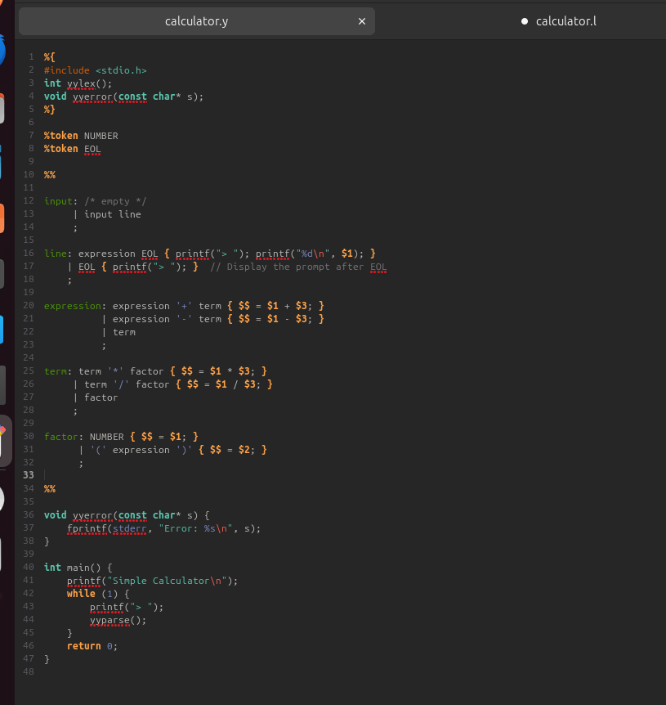
Process behind the Bison code:
Int yylex();
Declaration of the lexer function
void yyerror(const char* s);
%}
Declaration of the error handling function
%token NUMBER
%token EOL
%%
token definition to be used in the parser. Where we define NUMBER and EOL

Slide 13
Process behind the Bison code: (cont.)
// Grammar rules and actions
Input: /* empty */
| input line
;
Defines the grammar rule for input, allowing zero or more lines.
line: expression EOL {
printf(“> “); // prints the result of the expression and display the prompt
printf(“%d\n”, $1);
}
| EOL {
Printf(“> “);
}
;
// display the prompt after a new line

Slide 14
Process behind the Bison code: (cont.)
// expression: shows the arithmetic expression
Expression: expression ‘+’ term {
// Add the result of the left and right expression
$$ = $1 + $3;
}
| expression ‘-’ term {
// Subtract right expression from left expression
$$ = $1 - $3;
}
| term {
// if no addition or subtraction, result is the term
$$ = $1;
}
;

Slide 15
Process behind the Bison code: (cont.)
// term: presents multipication, division, or factor
term: term ‘*’ factor {
// multiply left and right terms
$$ = $1 * $3;
}
| term '/' factor {
// divides left term by right factor
$$ = $1 / $3;
}
| factor
// if no multiplication or division, result is the factor
;

Slide 16
Process behind the Bison code: (cont.)
// factor: shows a number or expression in parentheses
factor: NUMBER {
// the factor is a number, and result is the number itself
$$ = $1;
}
| ‘(‘ expression ‘)’ {
// the factor is a expression in parentheses, so result is the expression result
$$ = $2;
}
;
%%

Slide 17
Process behind the Bison code: (cont.)
// Error handling function
Void yyerror (const char* s){
// prints a error message to the standard error output
Fprintf(stderr, “Error: %s\n”, s);
}
int main() {
printf("Simple Calculator\n");
while (1) { printf("> ");
yyparse();
}
return 0;
}
The main function of the calculator program, where the message and the > print out, and invokes the parsing function yyparse() to process and evaluate the entered inputs

Slide 18
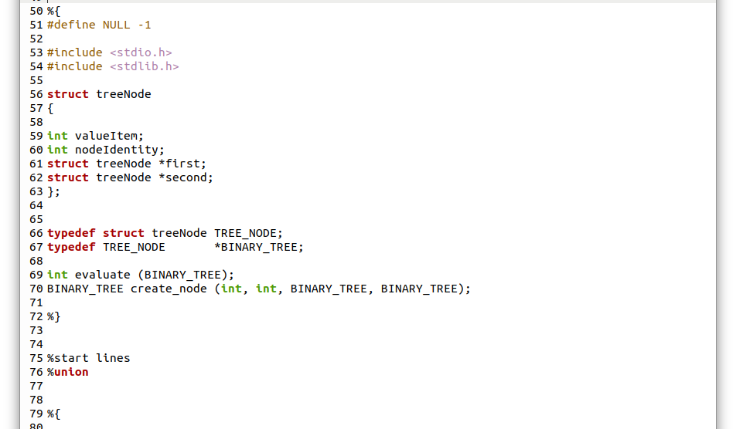
An attempt to add a parse tree
Here is a piece of code for a parse tree, although to our dismay it did not work. However, with this attempt, we did discover that Bison makes it possible for scanners like Flex to be able to just as well as identify possible nodes and create a parse tree w/ the help of Bison

Slide 19
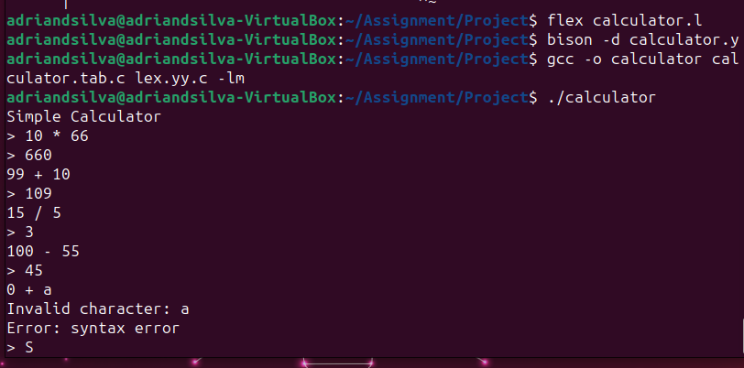
Results in Linux

Slide 20


Tools Used
http://www.jonathanbeard.io/tutorials/FlexBisonC++
https://learnmoderncpp.com/2020/12/16/generating-c-programs-with-flex-and-bison-1/
https://web.iitd.ac.in/~sumeet/flex__bison.pdf
https://www.talkplayfun.com/bison_flex/001_Bison_and_Flex_with_Cygwin_Bison_and_Flex.pptx https://aquamentus.com/flex_bison.html
https://youtu.be/POjnw0xEVas?si=zAoCOGOSo8RTtYH6
https://www.cse.scu.edu/~m1wang/compiler/TutorialFlexBison.pdf#:~:text=Flex%20is%20a%20scanner%20generator%20tool%20for%20lexical,implement%20the%20scanner%20according%20to%20the%20input%20rules.

Slide 21
Thanks
Thanks for coming

